Slide 1
Lecture on
Floating Point Number Representation
&
Microprogramming
Prof. Atal Chaudhuri
Dept. of Computer Science & Engineering
Jadavpur University

Slide 2
Floating Point Number Representation

Slide 3
Floating Point Representation
The floating-point representation of a number has two parts.
Mantissa, a signed fixed-point number (may be a fraction or an integer).
Exponent, designates the position of the decimal point.
If the mantissa is m & exponent is e then the two parts represent a number obtained from multiplying m times a radix r raised to the value of e; thus m x r^{e}.

Slide 4
Example & Purpose of
Floating Point Number
Example: Assume a fraction representation and a radix 10. The decimal number 537.25 is represented in a register with m = 53725 and e = 3 and is interpreted to represent the floating-point number .53725 x 10³.
Purpose: It increases the range of numbers that can be accommodated in a given register.

Slide 5
Normalization of Floating Point Number
A floating point number is normalized if the most significant digit of the mantissa is nonzero.
Mantissa contains the maximum possible number of significant digits.
A zero cannot be normalized because it does not have a non-zero digit.
It is represented in floating point by all 0’s in the mantissa & exponent.

Slide 6
Types of Representation of
Floating-Point Numbers
IEEE Standard for Floating Point Numbers.
1. IEEE Single precision format.
2. IEEE Double precision format.

Slide 7
IEEE Standard for Floating Point Numbers.
IEEE Single precision format (32 bits).
Developed by IEEE .
Standard describes both the representation & the way in which the four basic arithmetic operations are to be performed.
The sign of the number is given in the 1st bit, followed by a representation for the exponent of 8 bits & last 23 bits represent the mantissa.

Slide 8
excess-x Representation
Instead of the signed exponent, E, the value actually stored in the exponent field is an unsigned integer E/=E+127. This is called the excess-127 format.
E/ is in the range 0 ≤ E / ≤ 255. The end values of this range, 0 and 255, are used to represent special values.
Therefore, the range of E/ for normal values is 1 ≤ E/ ≤ 254.
This means that the actual exponent, E, is in the range -126 ≤ E ≤ 127.

Slide 9
Diagram of IEEE Single precision format (32 bits).
S E/ M
Sign of numbers:
23-bit mantissa fraction
8-bit signed exponent in excess -127 format
0 → +
1 → -

Slide 10
Example of Single Precision Representation
Un-normalized Value
0 10001000 0010110…
Sign bit Excess-127 exponent Mantissa
(There is no implicit 1 to the left of the binary point)
Value represented = + 0.0010110….. x 2⁹

Slide 11
Example of Single Precision Representation
Normalized Value
0 10000101 0110…
Sign bit Excess-127 exponent Mantissa
Value represented = + 1.0110….. x 2⁶

Slide 12
IEEE Single precision format (32 bits).
The 32-bit standard representation is called a single precision representation because it occupies a single 32-bit word.
Scale factor range: 2⁻¹²⁶ to 2⁺¹²⁷
The 23 bit mantissa provides approximately the same precision as a 7-digit decimal value.
A computer must provide at least single-precision representation to conform to the IEEE standard.

Slide 13
IEEE Double precision format (64 bits)
To provide more precision and range for floating point numbers, IEEE specifies a double precision format .
The double precision format has increased exponent & mantissa ranges.
The sign of the number is given in the 1st bit, followed by a representation for the exponent of 11 bits & last 52 bits represent the mantissa.

Slide 14
IEEE Double precision format (64 bits)
The 11-bits excess-1023 exponent E/ has the range 1 ≤ E/ ≤ 2046 for normal values, with 0 and 2047 used to indicate special values, as before. Thus the actual exponent E is in the range -1022 ≤ E ≤ 1023, providing scale factors of 2⁻¹⁰²² to 2⁺¹⁰²³.
Thus 53-bit mantissa provides a precision equivalent to about 16 decimal digits.

Slide 15
Diagram of IEEE Double precision format (64 bits).
S E/ M
Sign of numbers
52-bit mantissa fraction
11-bit signed exponent in
excess -1023 format

Slide 16
Arithmetic Operations on
Floating Point Numbers
Add/Subtract Rule
Choose the number with the smaller exponent and shift its mantissa right a number of steps equal to the difference in exponent.
Set the exponent of the result equal to the larger exponent.
Perform addition/subtraction on the mantissas and determine the sign of the result.
Normalize the resulting value, if necessary.

Slide 17
Arithmetic Operations on
Floating Point Numbers
Multiply Rule
Add the exponents & subtract 127.
Multiply the mantissas and determine the sign of the result.
Normalize the resulting value, if necessary.

Slide 18
Arithmetic Operations on
Floating Point Numbers
Divide Rule
Subtract the exponent of divisor from the exponent of dividend & add 127.
Divide the mantissa of dividend by the mantissa of divisor and determine the sign of the result.
Normalize the resulting value, if necessary.

Slide 19
Methods of Truncation
Chopping
Von Neumann Rounding
Rounding

Slide 20
Chopping
Simplest way is to remove the guard bits and make no changes in retained bits.
Example: - Suppose we want to truncate a fraction from six to three bits by this method. All fractions in the range 0.b-1 b-2 b-3 0 0 0 to 0. b-1 b-2 b-3 111 are truncated to 0. b-1 b-2 b-3. The error in the 3-bit result ranges from 0 to 0.000111.
The result of chopping is a biased approximation because the error range is not symmetrical about 0.

Slide 21
Von-Neumann Rounding
The excess bits are removed and the LSB of the retained bits is set to 1 irrespective of the bits which are removed.
Error Range: Between (-)1 and (+)1 in the LSB position of the retained bits.
It is an unbiased approximation.

Slide 22
Rounding
It achieves the closest approximation to the number being truncated and is an unbiased technique.
Procedure: A ‘1’ is added to the LSB position of the bits to be retained if there is a ‘1’ in the MSB position of the bits being removed. Thus 0. b-1 b-2 b-31…is rounded to 0. b-1 b-2 b-3 + 0.001, and 0. b-1 b-2 b-3 0…… is rounded to 0. b-1 b-2 b-3.
Error Range: The error range is approximately -1/2 to +1/2 in the LSB position of the retained bits.

Slide 23
Microprogramming

Slide 24
What is Microprogramming?
Microcode is a set of elementary instructions in a complex instruction set computer (CISC).
Microcode enables the computer designer to create machine instructions without having to design electronic circuits.
A control unit whose control variables are stored in a memory is called a micro programmed control unit.
Each control word of memory is called a microinstruction & a sequence of microinstructions is called a micro program.

Slide 25
Micro-program Control Logic
Diagram
Next Address
Generator
Control Address
Register
Control Memory
(ROM)
External Input Condition
Initiate micro operation
Next Address information

Slide 26
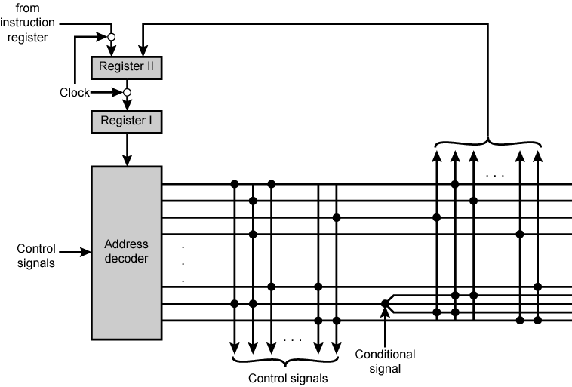
Wilkes's Micro programmed Control Unit

Slide 27
Wilkes Control
1951
Matrix partially filled with diodes
During cycle, one row activated
  Generates signals where diode present
  First part of row generates control
  Second generates address for next cycle

Slide 28
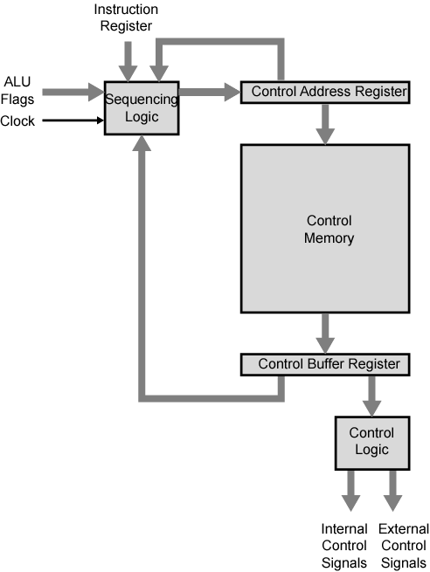
Control
Unit Organization

Slide 29
Implementation (1)
All the control unit does is to generate a set of control signals
Each control signal is either on or off
Represent each control signal by a bit
Have a control word for each micro-operation
Have a sequence of control words for each machine code instruction
Add an address to specify the next micro-instruction, depending on conditions

Slide 30
Implementation (2)
Today’s large microprocessor
  Many instructions and associated register-level hardware
  Many control points to be manipulated
This results in control memory that
  Contains a large number of words
    corresponding to the number of instructions to be executed
  Has a wide word width
    Due to the large number of control points to be manipulated

Slide 31
Flow Chart for sign magnitude addition & subtraction
T 0
Initial State
qs = 1
qa = 1
T 1
Bs←Bs/
As : Bs
S=1
S=0
T3
T4
A←A+B/+1
E← Cout
T2
A←A+B
E ← Cout
0 =
E
= 1
A < B
A >= B
A←A/
T6
E←0
T5
A←A+1
As←As/
T7

Slide 32
Data Processor Register & ALU
y
Bs
B register
ALU
S2
Cout
S1
S0
Cin
z
As
E
A register
L(Load)
w

Slide 33
Control Block Diagram
Diagram
qa
S Control Logic
x
s2
qs
s1
s0
Cin
As X-OR Bs
L
y
E
z
w

Slide 34
Control State Diagram
qa → Add, qs → Subtract, S = 0 → Signs alike, S = 1 → Signs unlike, E → Output Carry
qa = 0
qs = 0
T0
qs = 1
T1
qa = 1
T3
S = 0
T2
E = 1
T7
S = 1
T4
T6
T5
E = 0

Slide 35
Sequence of Register Transfers
 | CONTROL O/P
 | x | s2 | s1 | s0 | C in | L | Y | Z | w
To: Initial State x=1 | 1 | 0 | 0 | 0 | 0 | 0 | 0 | 0 | 0
T1: Bs ← Bs/ | 0 | 0 | 0 | 0 | 0 | 0 | 1 | 0 | 0
T2: Nothing | 0 | 0 | 0 | 0 | 0 | 0 | 0 | 0 | 0
T3: A←A+B, E← Cout | 0 | 0 | 0 | 1 | 0 | 1 | 0 | 0 | 0
T4: A←A+B/+1, E← Cout | 0 | 0 | 1 | 0 | 1 | 1 | 0 | 0 | 0
T5: E ← 0 | 0 | 0 | 0 | 0 | 0 | 0 | 0 | 0 | 1
T6: A ← A/ | 0 | 1 | 1 | 1 | 0 | 1 | 0 | 0 | 0
T7: A←A+1,As← As/ | 0 | 0 | 0 | 0 | 1 | 1 | 0 | 1 | 0

Slide 36
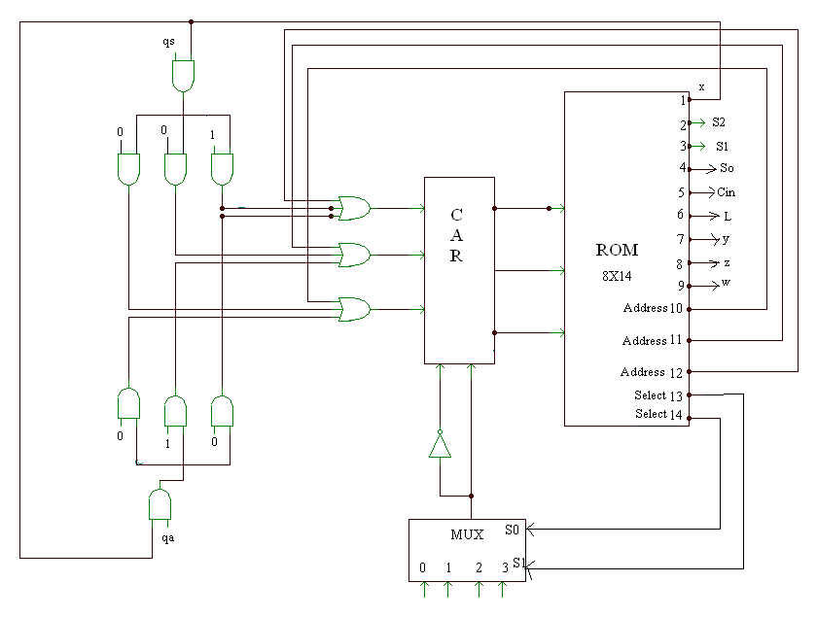
Increment
Load
0 1 S E
Micro program control block diagram

Slide 37
Binary Micro-program for control memory
ROM ADDRESS |  |  | ROM OUTPUTS
 |  |  | x | s2 | s1 | s0 | Cin | L | y | z | w | Address |  |  | Select
 |  |  | 1 | 2 | 3 | 4 | 5 | 6 | 7 | 8 | 9 | 10 | 11 | 12 | 13 | 14
0 | 0 | 0 | 1 | 0 | 0 | 0 | 0 | 0 | 0 | 0 | 0 | 0 | 0 | 0 | 0 | 1
0 | 0 | 1 | 0 | 0 | 0 | 0 | 0 | 0 | 1 | 0 | 0 | 0 | 1 | 0 | 0 | 1
0 | 1 | 0 | 0 | 0 | 0 | 0 | 0 | 0 | 0 | 0 | 0 | 1 | 0 | 0 | 1 | 0
0 | 1 | 1 | 0 | 0 | 0 | 1 | 0 | 1 | 0 | 0 | 0 | 0 | 0 | 0 | 0 | 1
1 | 0 | 0 | 0 | 0 | 1 | 0 | 1 | 1 | 0 | 0 | 0 | 1 | 0 | 1 | 0 | 1
1 | 0 | 1 | 0 | 0 | 0 | 0 | 0 | 0 | 0 | 0 | 1 | 0 | 0 | 0 | 1 | 1
1 | 1 | 0 | 0 | 1 | 1 | 1 | 0 | 1 | 0 | 0 | 0 | 1 | 1 | 1 | 0 | 1
1 | 1 | 1 | 0 | 0 | 0 | 0 | 1 | 1 | 0 | 1 | 0 | 0 | 0 | 0 | 0 | 1

Slide 38
Micro-program Word Length
Based on 3 factors
  Maximum number of simultaneous micro-operations supported
  The way control information is represented or encoded
  The way in which the next micro-instruction address is specified

Slide 39
Micro-instruction Types
Each micro-instruction specifies single (or few) micro-operations to be performed
  (vertical micro-programming)
Each micro-instruction specifies many different micro-operations to be performed in parallel
  (horizontal micro-programming)

Slide 40
Vertical Micro-programming
Width is narrow
n control signals encoded into log₂ n bits
Limited ability to express parallelism
Considerable encoding of control information requires external memory word decoder to identify the exact control line being manipulated

Slide 41
Horizontal Micro-programming
Wide memory word
High degree of parallel operations possible
Little encoding of control information

Slide 42
Microinstruction Format
A major design effort has its emphasis on minimizing the length of microinstruction. The length of the microinstruction decides the size of the control memory, as well as the cost involved with this approach.
The length of microinstruction is related to the following: -
Degree of parallelism
The control field organization
The method by which the next address is specified.

Slide 43
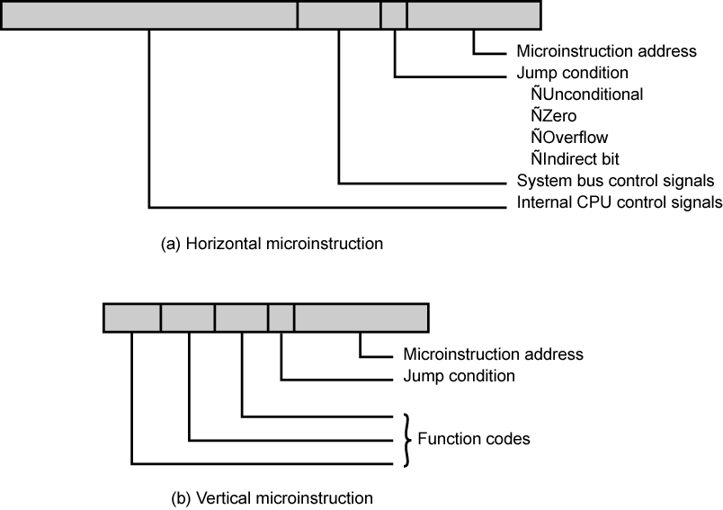
Typical Microinstruction Formats

Slide 44
Compromise
Divide control signals into disjoint groups
Implement each group as separate field in memory word
Supports reasonable levels of parallelism without too much complexity

Slide 45
Organization of Control Information
A trivial way to organize the control field would be to have one bit for each control line that control the data processor allowing the full parallelism and there is no need for decoding the control field. This method however leads to inefficient use of control memory space when it is not required to invoke all control operations simultaneously.

Slide 46
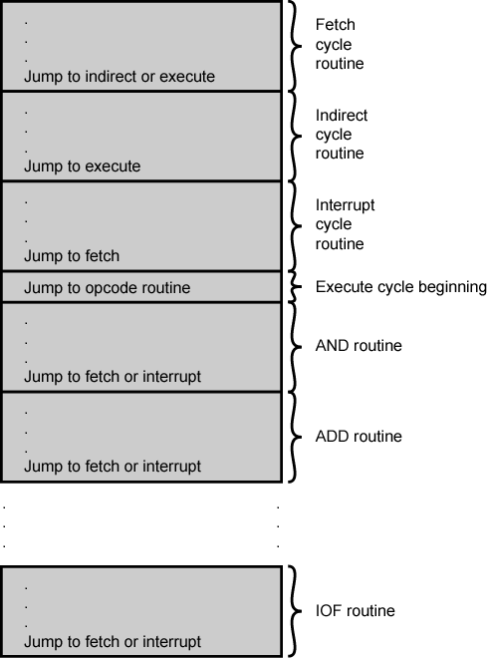
Organization of
Control Memory

Slide 47
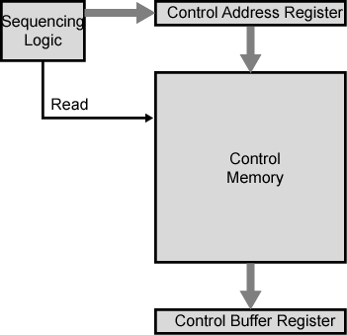
Control Unit

Slide 48
Control Unit Function
Sequence logic unit issues read command
Word specified in control address register is read into control buffer register
Control buffer register contents generates control signals and next address information
Sequence logic loads new address into control buffer register based on next address information from control buffer register and ALU flags

Slide 49
Next Address Decision
Depending on ALU flags and control buffer register
  Get next instruction
    Add 1 to control address register
  Jump to new routine based on jump microinstruction
    Load address field of control buffer register into control address register
  Jump to machine instruction routine
    Load control address register based on op-code in IR

Slide 50
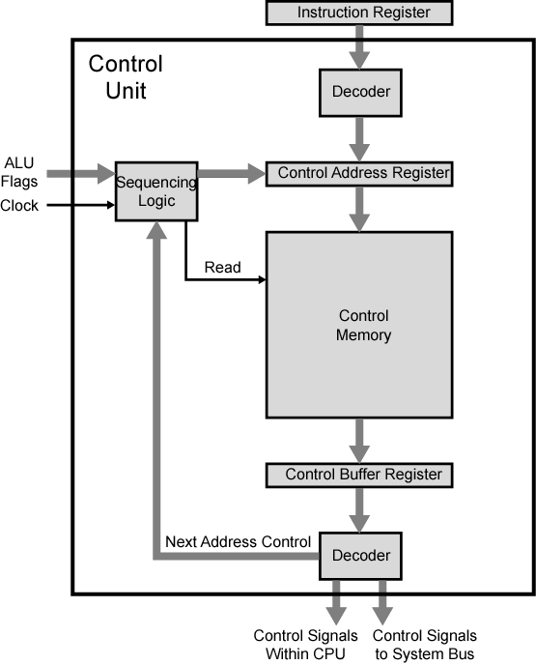
Functioning of
Micro
Programmed
Control Unit

Slide 51
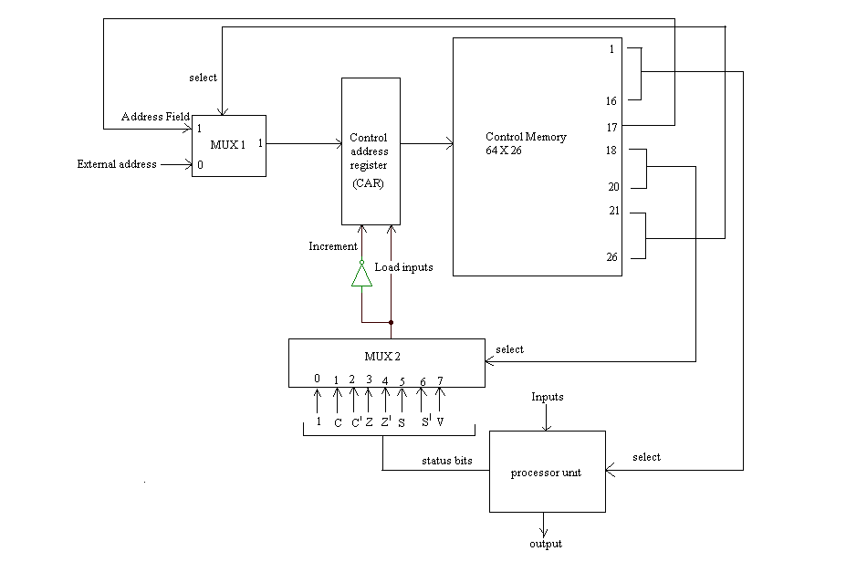
Micro-program Control for processor unit

Slide 52
Advantages and Disadvantages of Microprogramming
Simplifies design of control unit
  Cheaper
  Less error-prone
Slower

Slide 53
Tasks Done By Micro programmed Control Unit
Microinstruction sequencing
Microinstruction execution
Must consider both together

Slide 54
Design Considerations
Size of microinstructions
Address generation time
  Determined by instruction register
    Once per cycle, after instruction is fetched
  Next sequential address
    Common in most designed
  Branches
    Both conditional and unconditional

Slide 55
Sequencing Techniques
Based on current microinstruction, condition flags, contents of IR, control memory address must be generated
Based on format of address information
  Two address fields
  Single address field
  Variable format

Slide 56
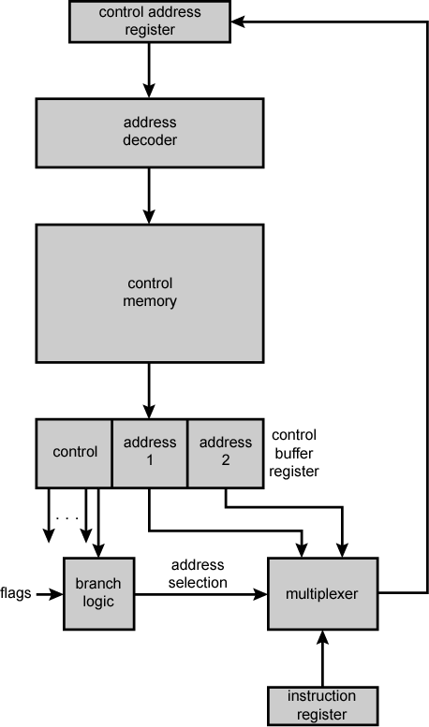
Branch Control Logic:
Two Address Fields

Slide 57
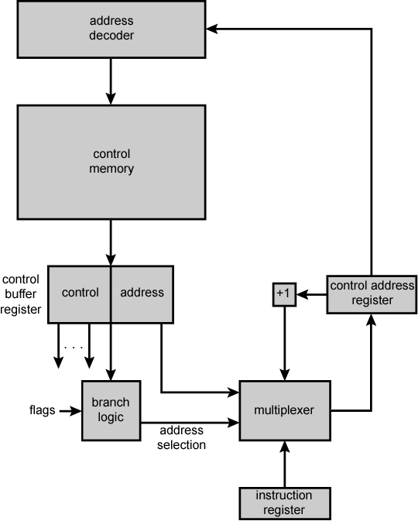
Branch Control
Logic: Single
Address Field

Slide 58
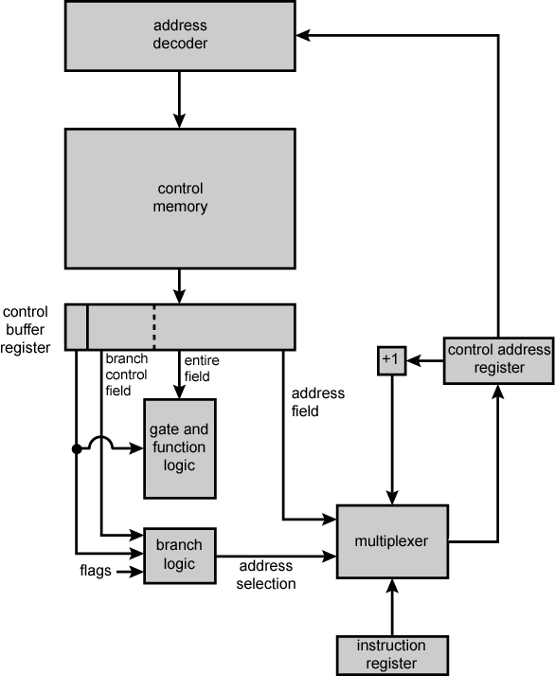
Branch Control
Logic: Variable
Format

Slide 59
Execution
The cycle is the basic event
Each cycle is made up of two events
  Fetch: -
  Determined by generation of microinstruction address
  Execute: -
  Effect is to generate control signals
Some control points internal to processor
Rest go to external control bus or other interface

